Slide 1
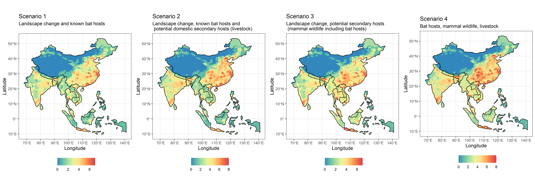
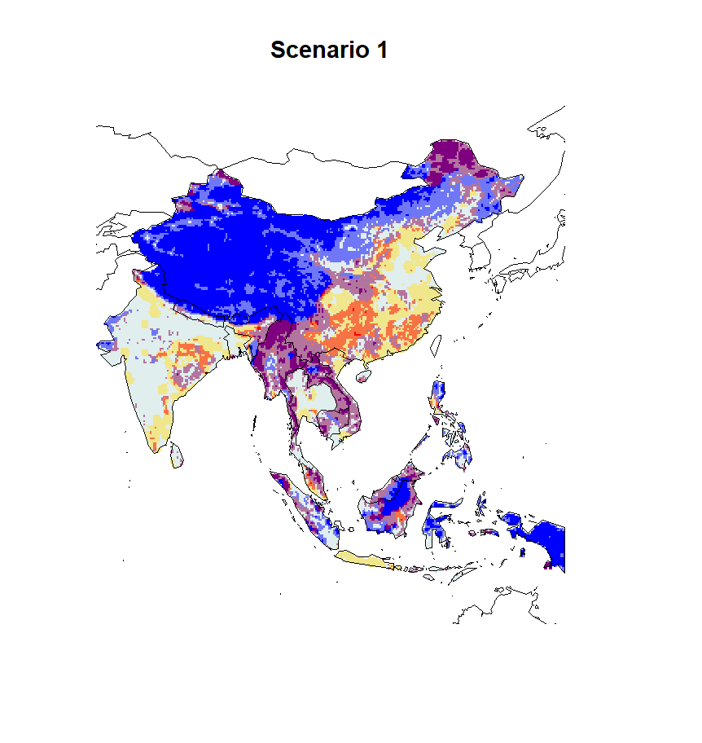


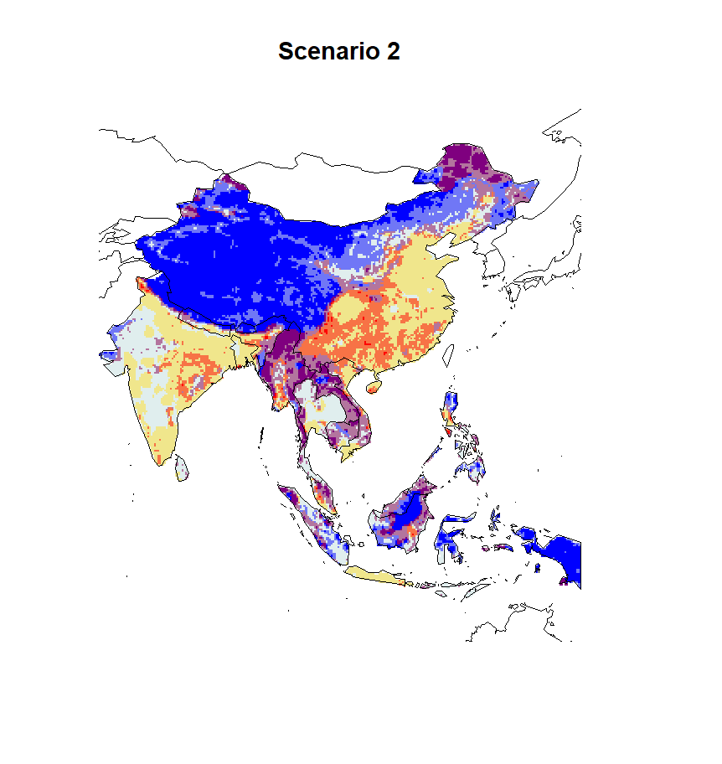

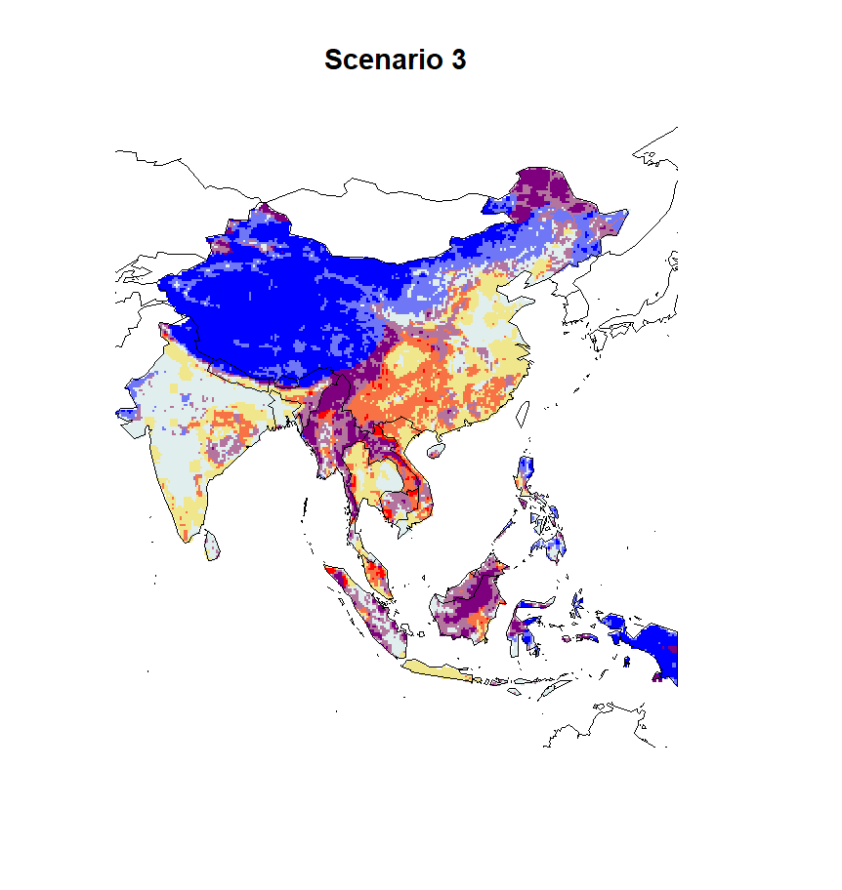

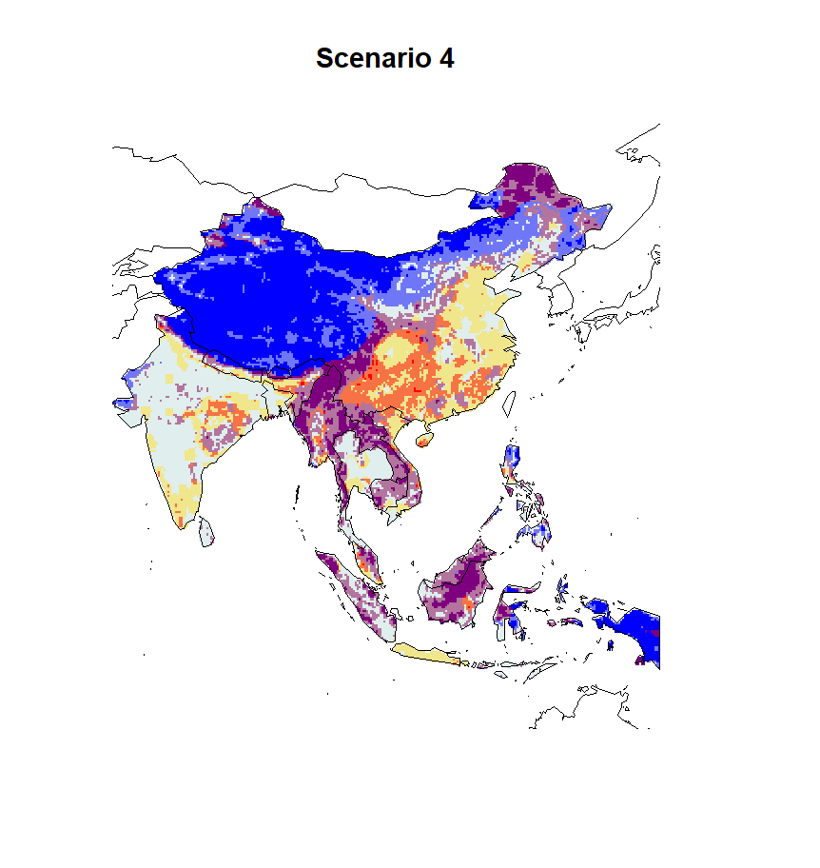
*
*

Slide 3
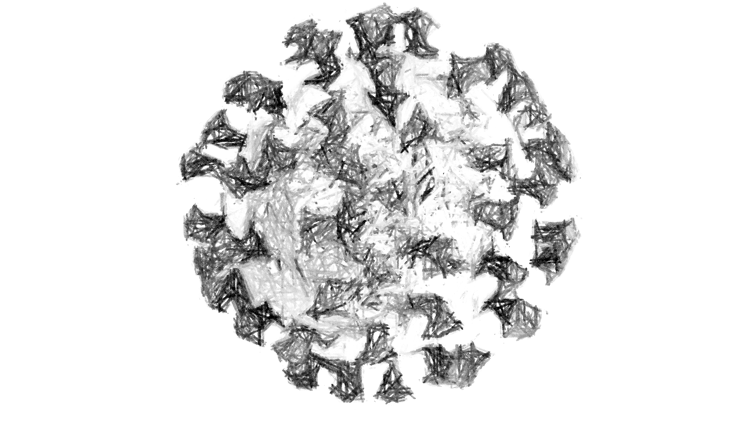




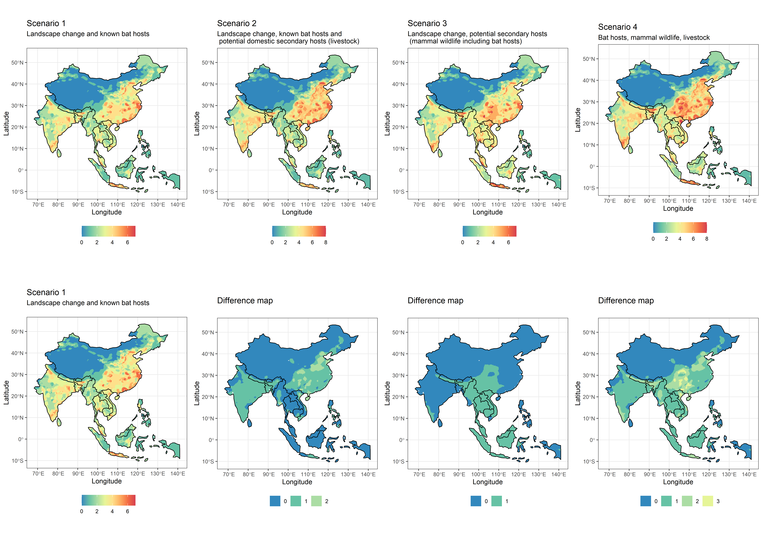

Slide 4
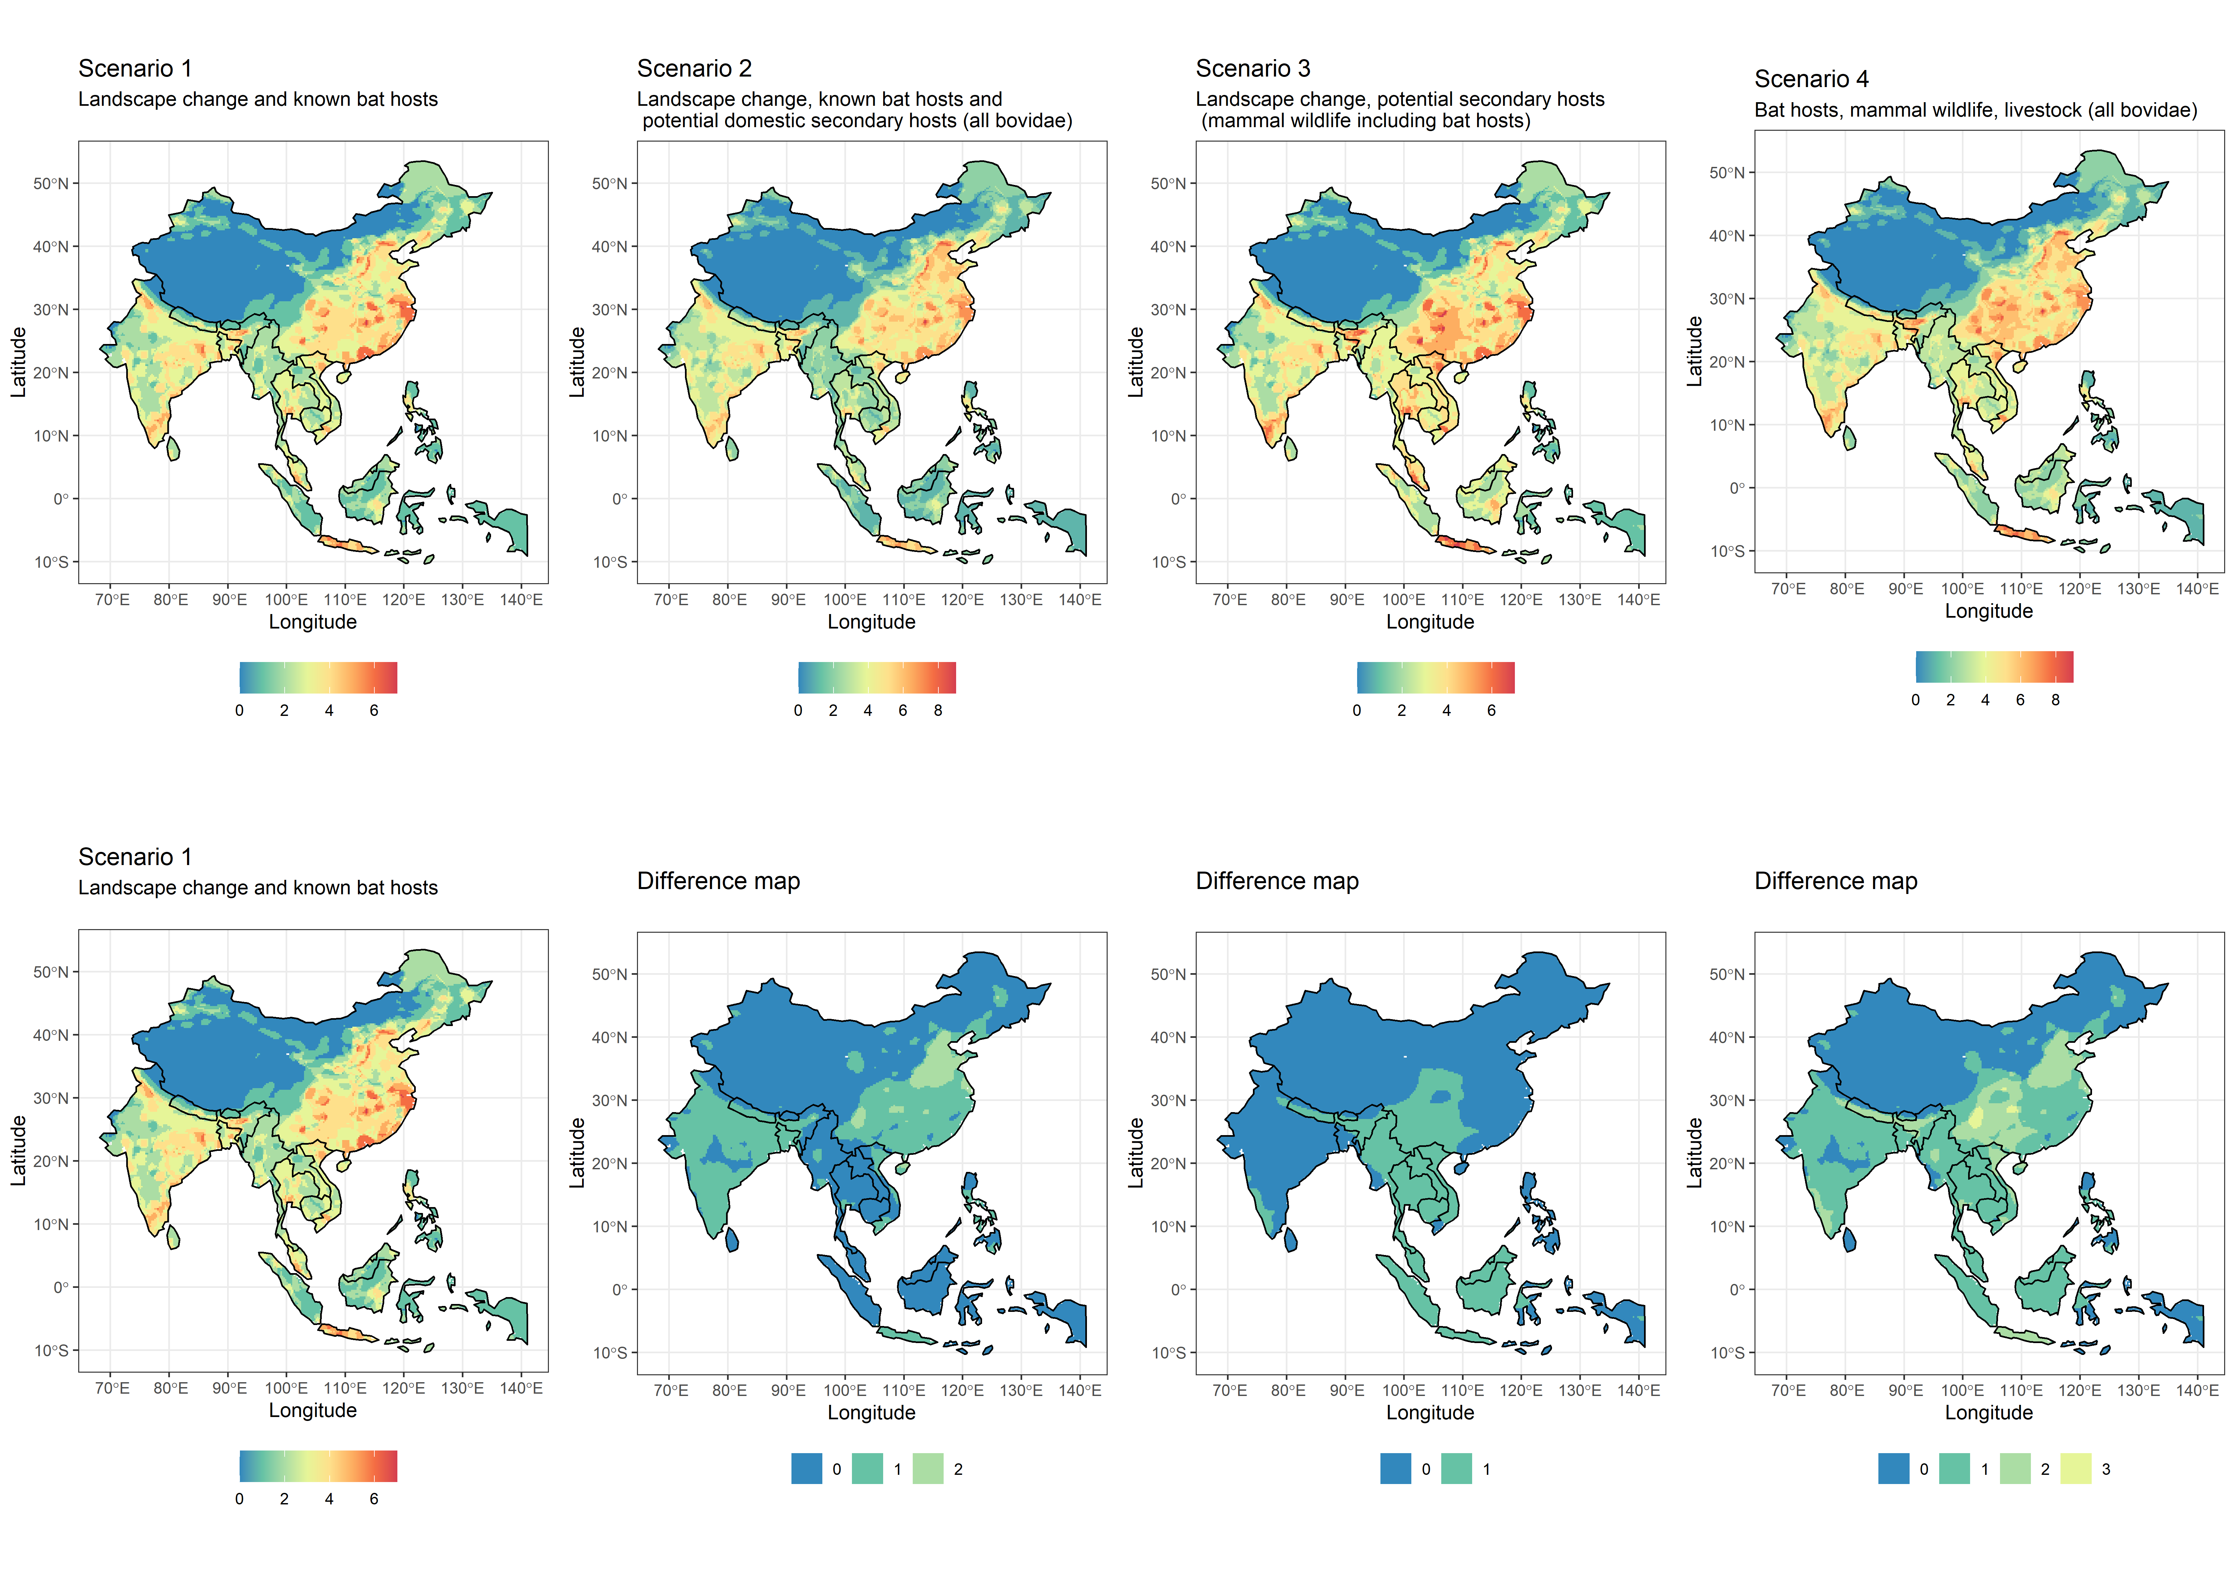

Slide 5
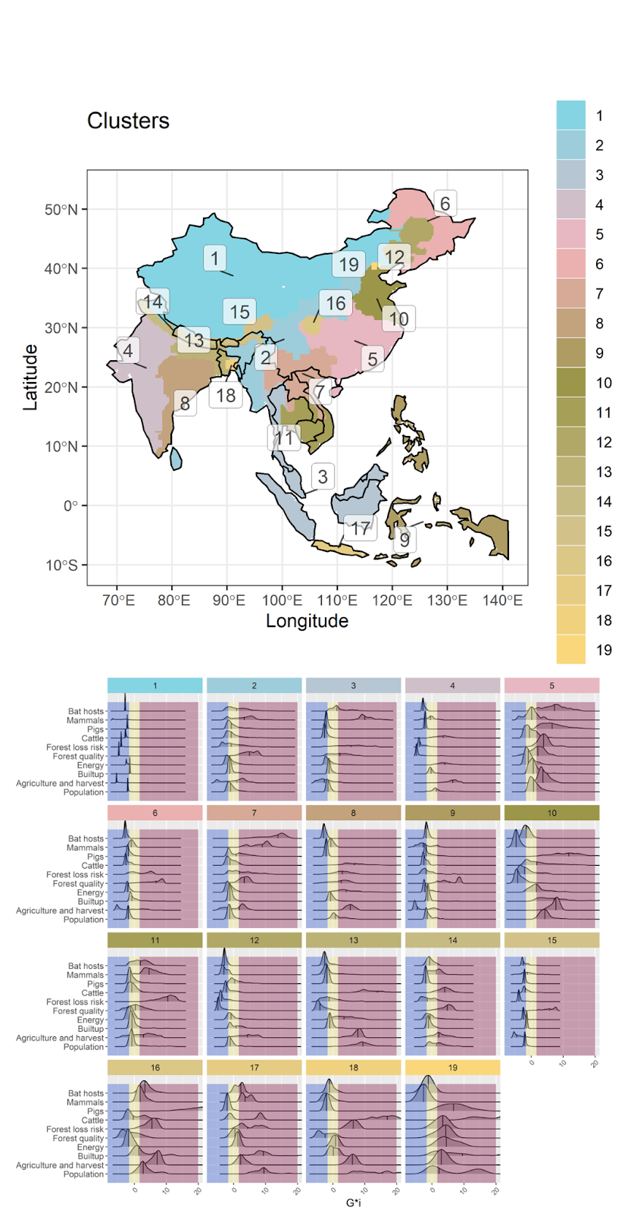
0
2
Cluster general geographical region names (indicative)
1 Inner-West China
2 Assam, West Burma block, Sri Lanka
3 West Thailand, most of Sundaland islands
4 West India
5 Central China
6 Manchuria
7 North Lao PDR, North Vietnam, South China
8 East India
9 (Philippines, Timor East, West Papua),
10 North China
11 Southwest Indochina
12 Inner Manchuria
13 Nepal, Bhutan, Bangladesh
14 North India
15 South Lhasa and Arunachal Pradesh
16 Yuzhong District, Chongqing
17 Java
18 East Bangladesh
19 Beijing

Slide 7
Cluster ID and region name (indicative) | N variables for which the median is a
 | Coldspot | Neutral spot | Hotspot | Total
1 Inner-West China | 9 | 1 | 0 | 10
2 Assam, West Burma block, Sri Lanka | 0 | 8 | 2 | 10
3 West Thailand, most of Sundaland islands | 3 | 4 | 3 | 10
4 West India | 4 | 3 | 3 | 10
5 Central China | 0 | 5 | 5 | 10
6 Manchuria | 6 | 3 | 1 | 10
7 North Lao PDR, North Vietnam, South China | 0 | 5 | 5 | 10
8 East India | 2 | 3 | 5 | 10
9 Philippines, Timor East, West Papua | 7 | 2 | 1 | 10
10 North China | 5 | 0 | 5 | 10
11 Southwest Indochina | 0 | 6 | 4 | 10
12 Inner Manchuria | 5 | 4 | 1 | 10
13 Nepal, Bhutan, Bangladesh | 4 | 2 | 4 | 10
14 North India | 1 | 6 | 3 | 10
15 South Lhasa and Arunachal Pradesh | 8 | 1 | 1 | 10
16 Shichuan and Yuzhong District, Chongqing | 2 | 2 | 6 | 10
17 Java | 1 | 2 | 7 | 10
18 East Bangladesh | 2 | 4 | 4 | 10
19 Beijing | 1 | 1 | 8 | 10
Total | 60 | 62 | 68 | 190

Slide 8
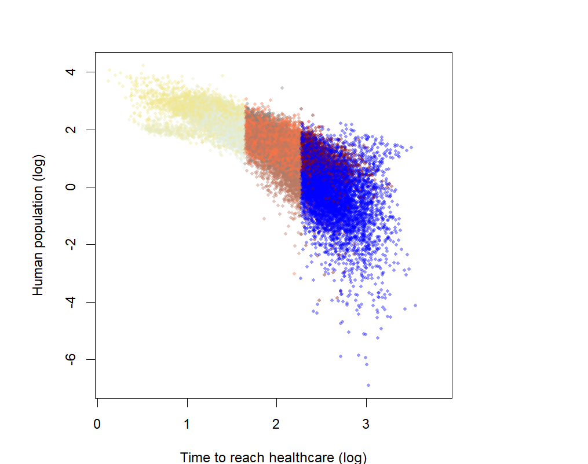
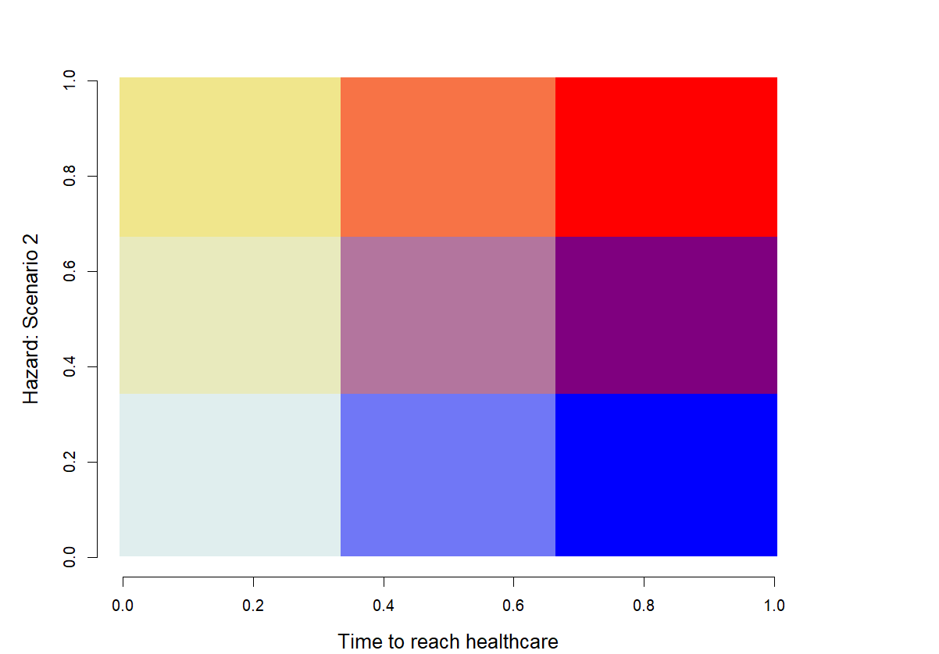
High potential for spread
Spillover debt:
Urgent action
Priority for discovery,
prioritise understanding known hosts, fast response
Prioritize
OneHealth,
Host discovery
and public health access
(surveillance, prevention, fixed
and mobile clinics, reduce
deforestation risk)
Assessed risk
Host bias reduction and prevention from surveillance and response
Conditionally safer zones:
focus on other
risks reduction
- Time to reach healthcare +

Slide 9
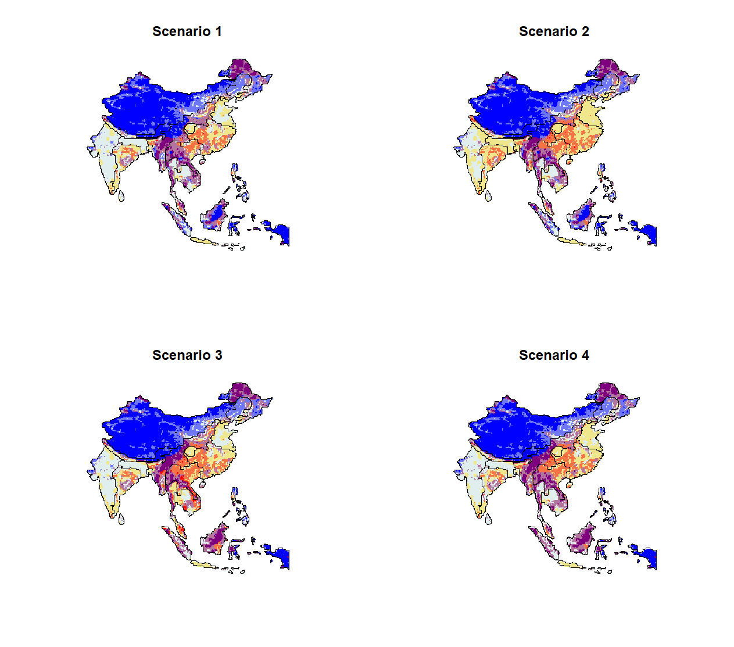
- Risk +
- Time to healthcare +

Slide 10
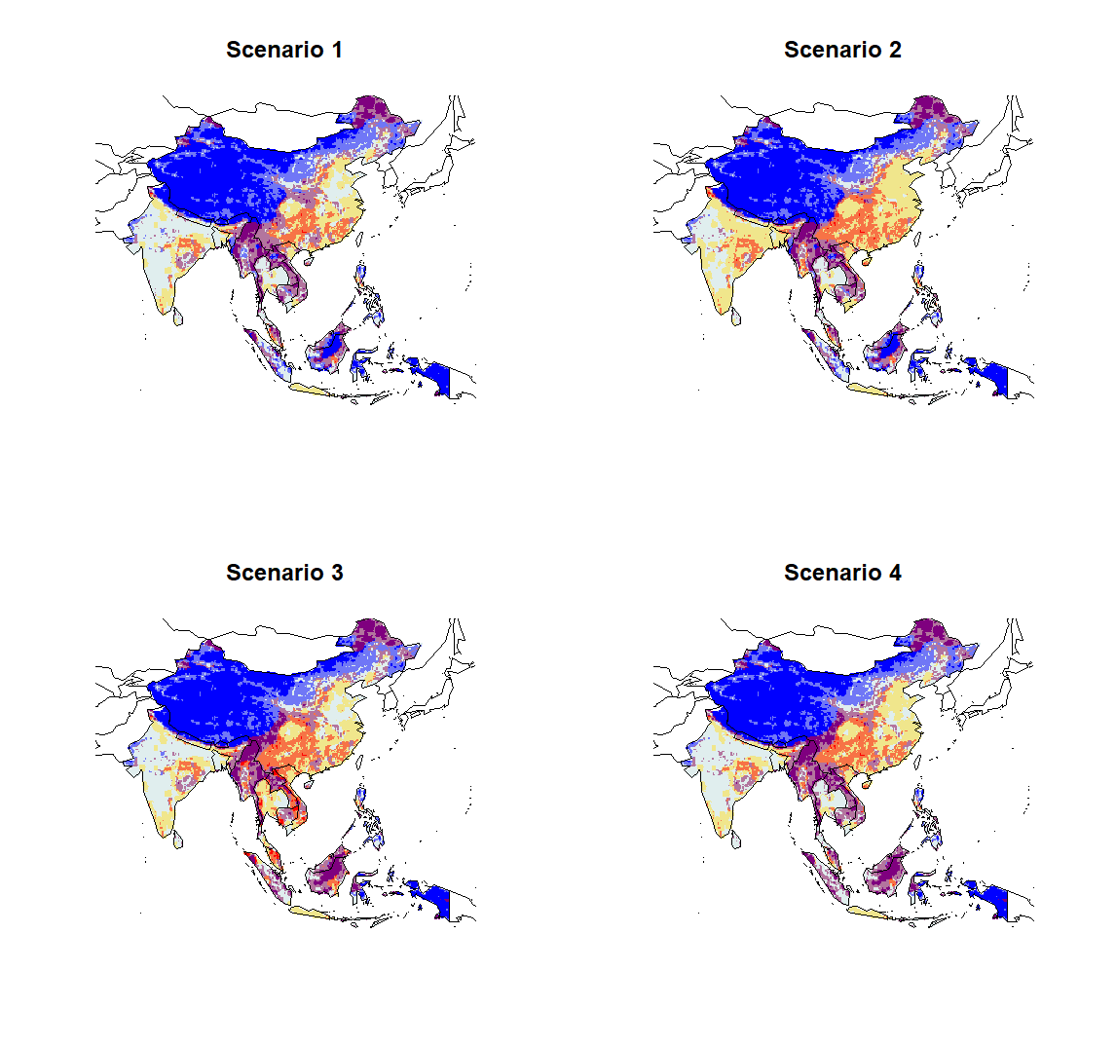
- Risk +
- Time to healthcare +

Slide 11
[,1] [,2] [,3] [,4]
[1,] "#E0EEEE" "#E0EEEE" "#7077F6" "#0000FF"
[2,] "#E0EEEE" "#E0EEEE" "#7077F6" "#0000FF"
[3,] "#E8EABD" "#E8EABD" "#B3759E" "#7F007F"
[4,] "#F0E68C" "#F0E68C" "#F77346" "#FF0000"
3
9
12
- Risk +
2
8
11
1
7
10
- Time to reach healthcare +

Slide 12
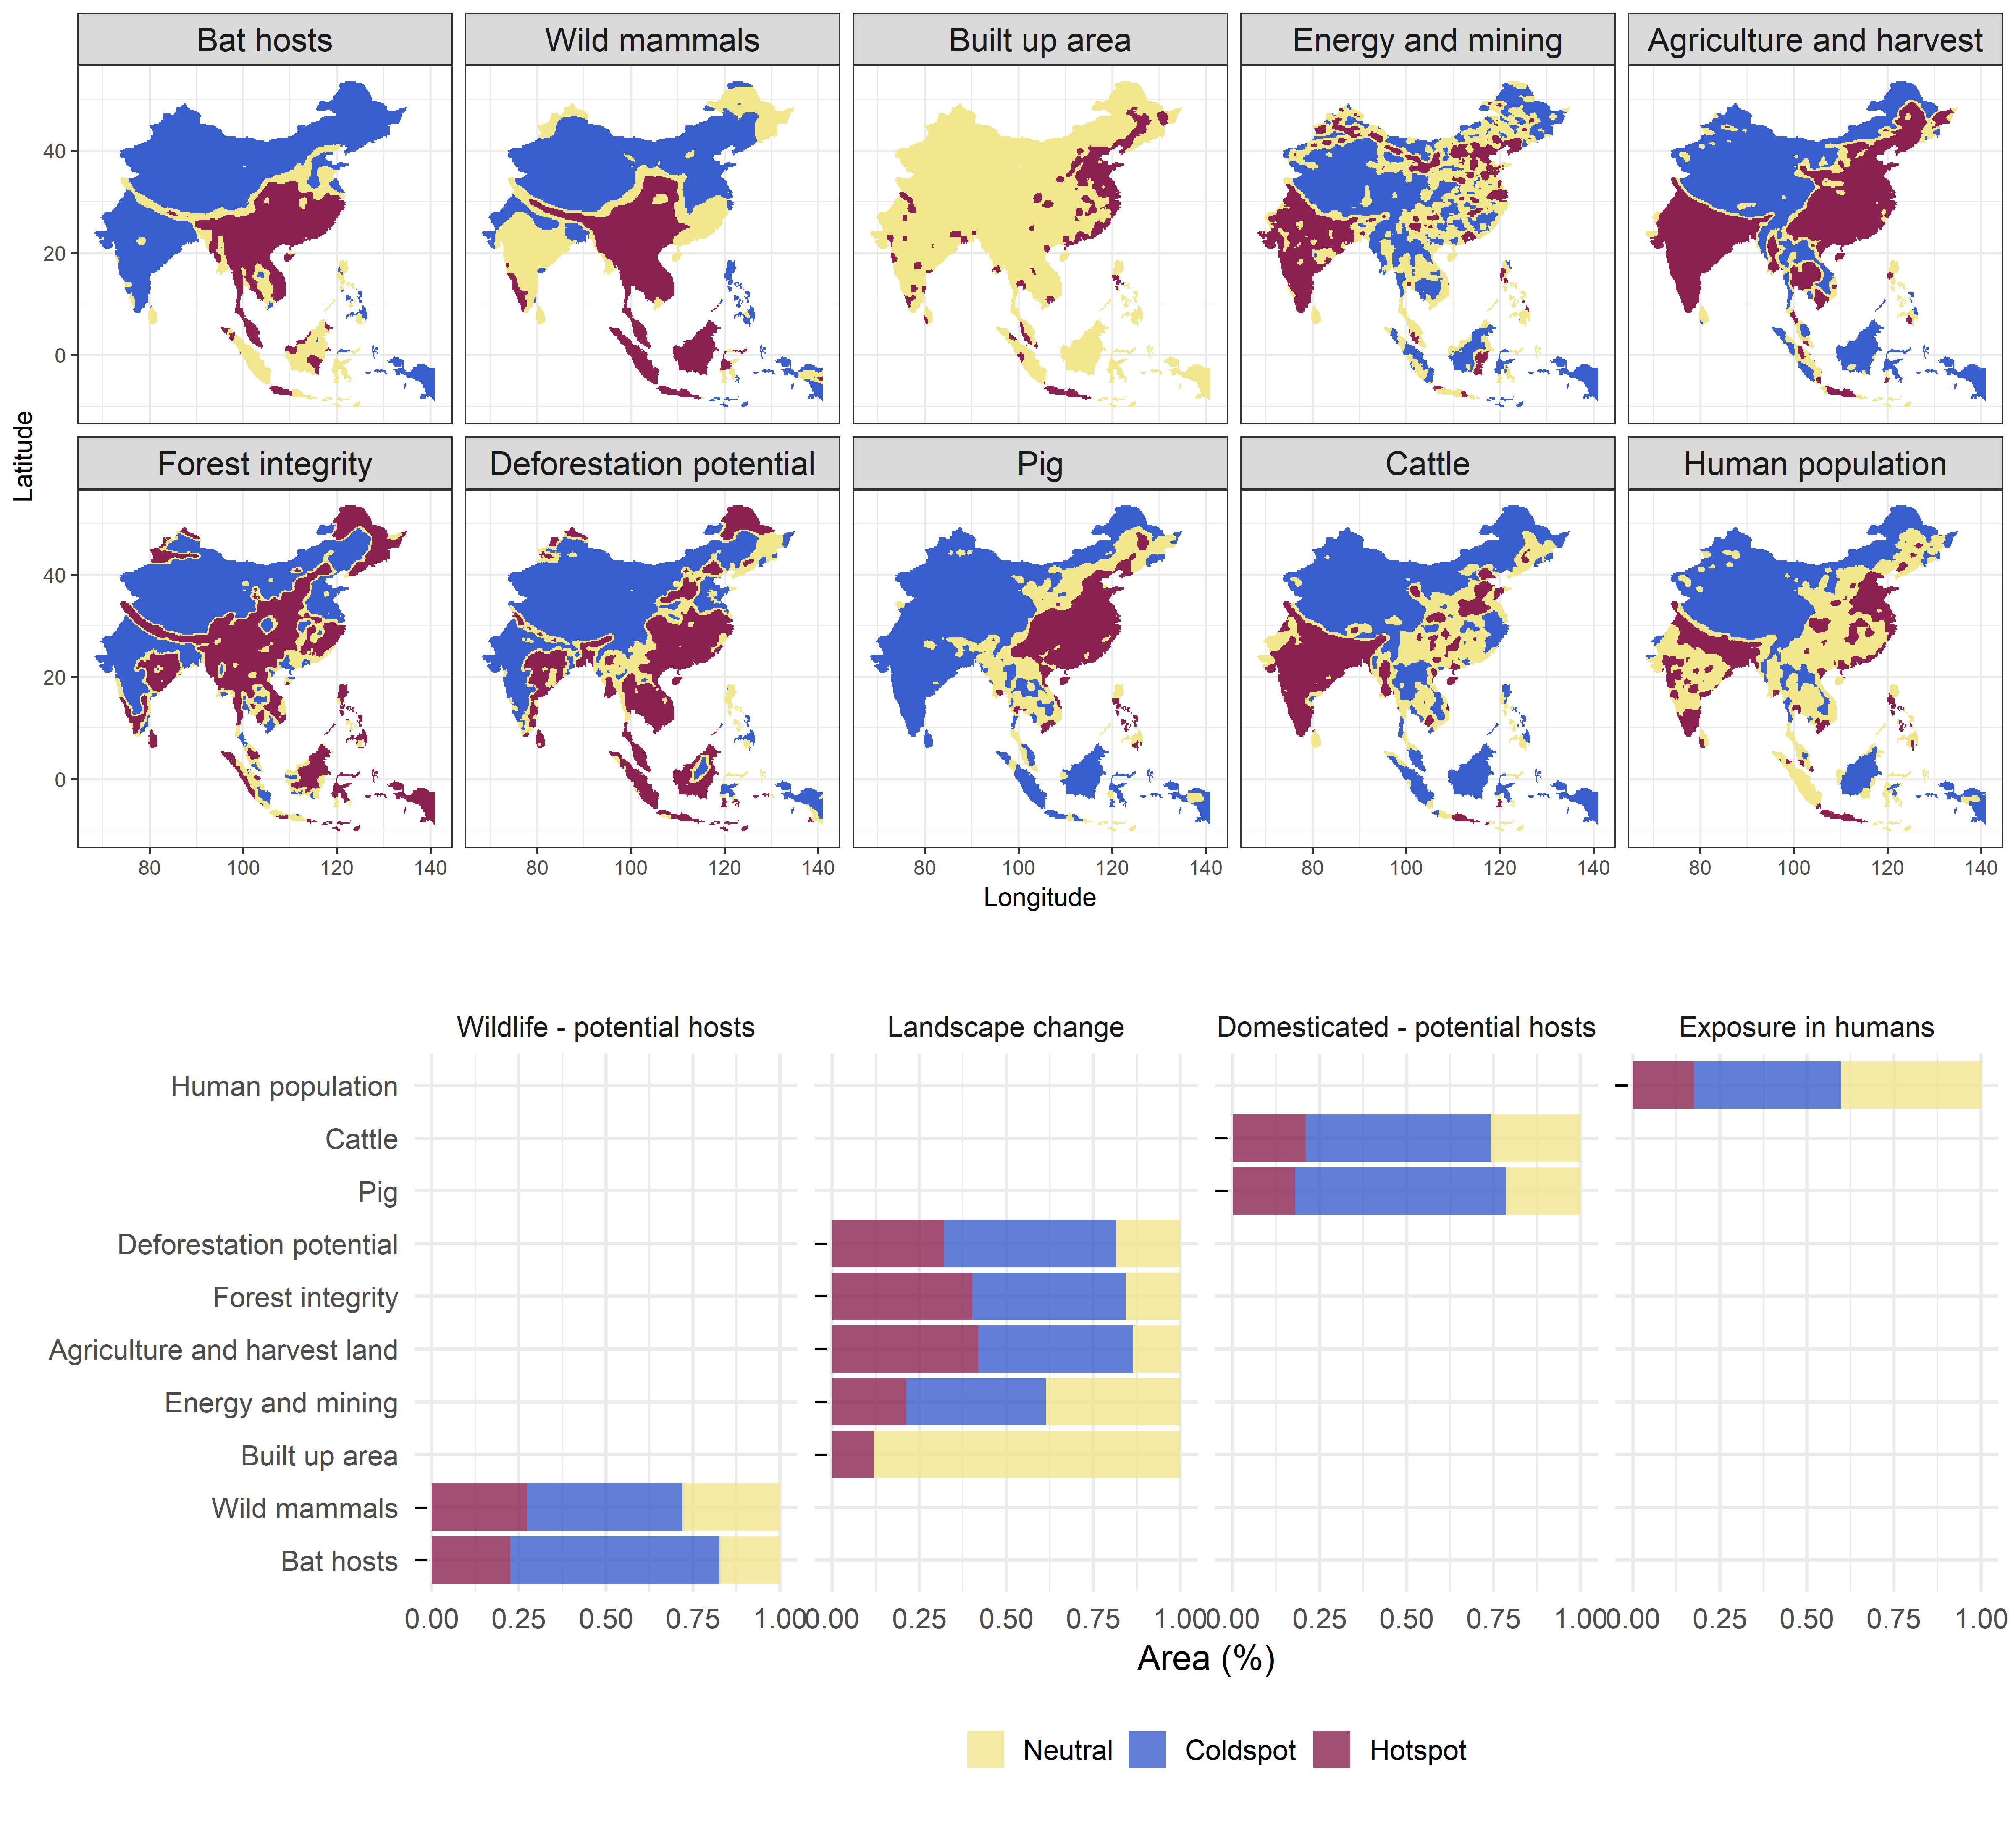
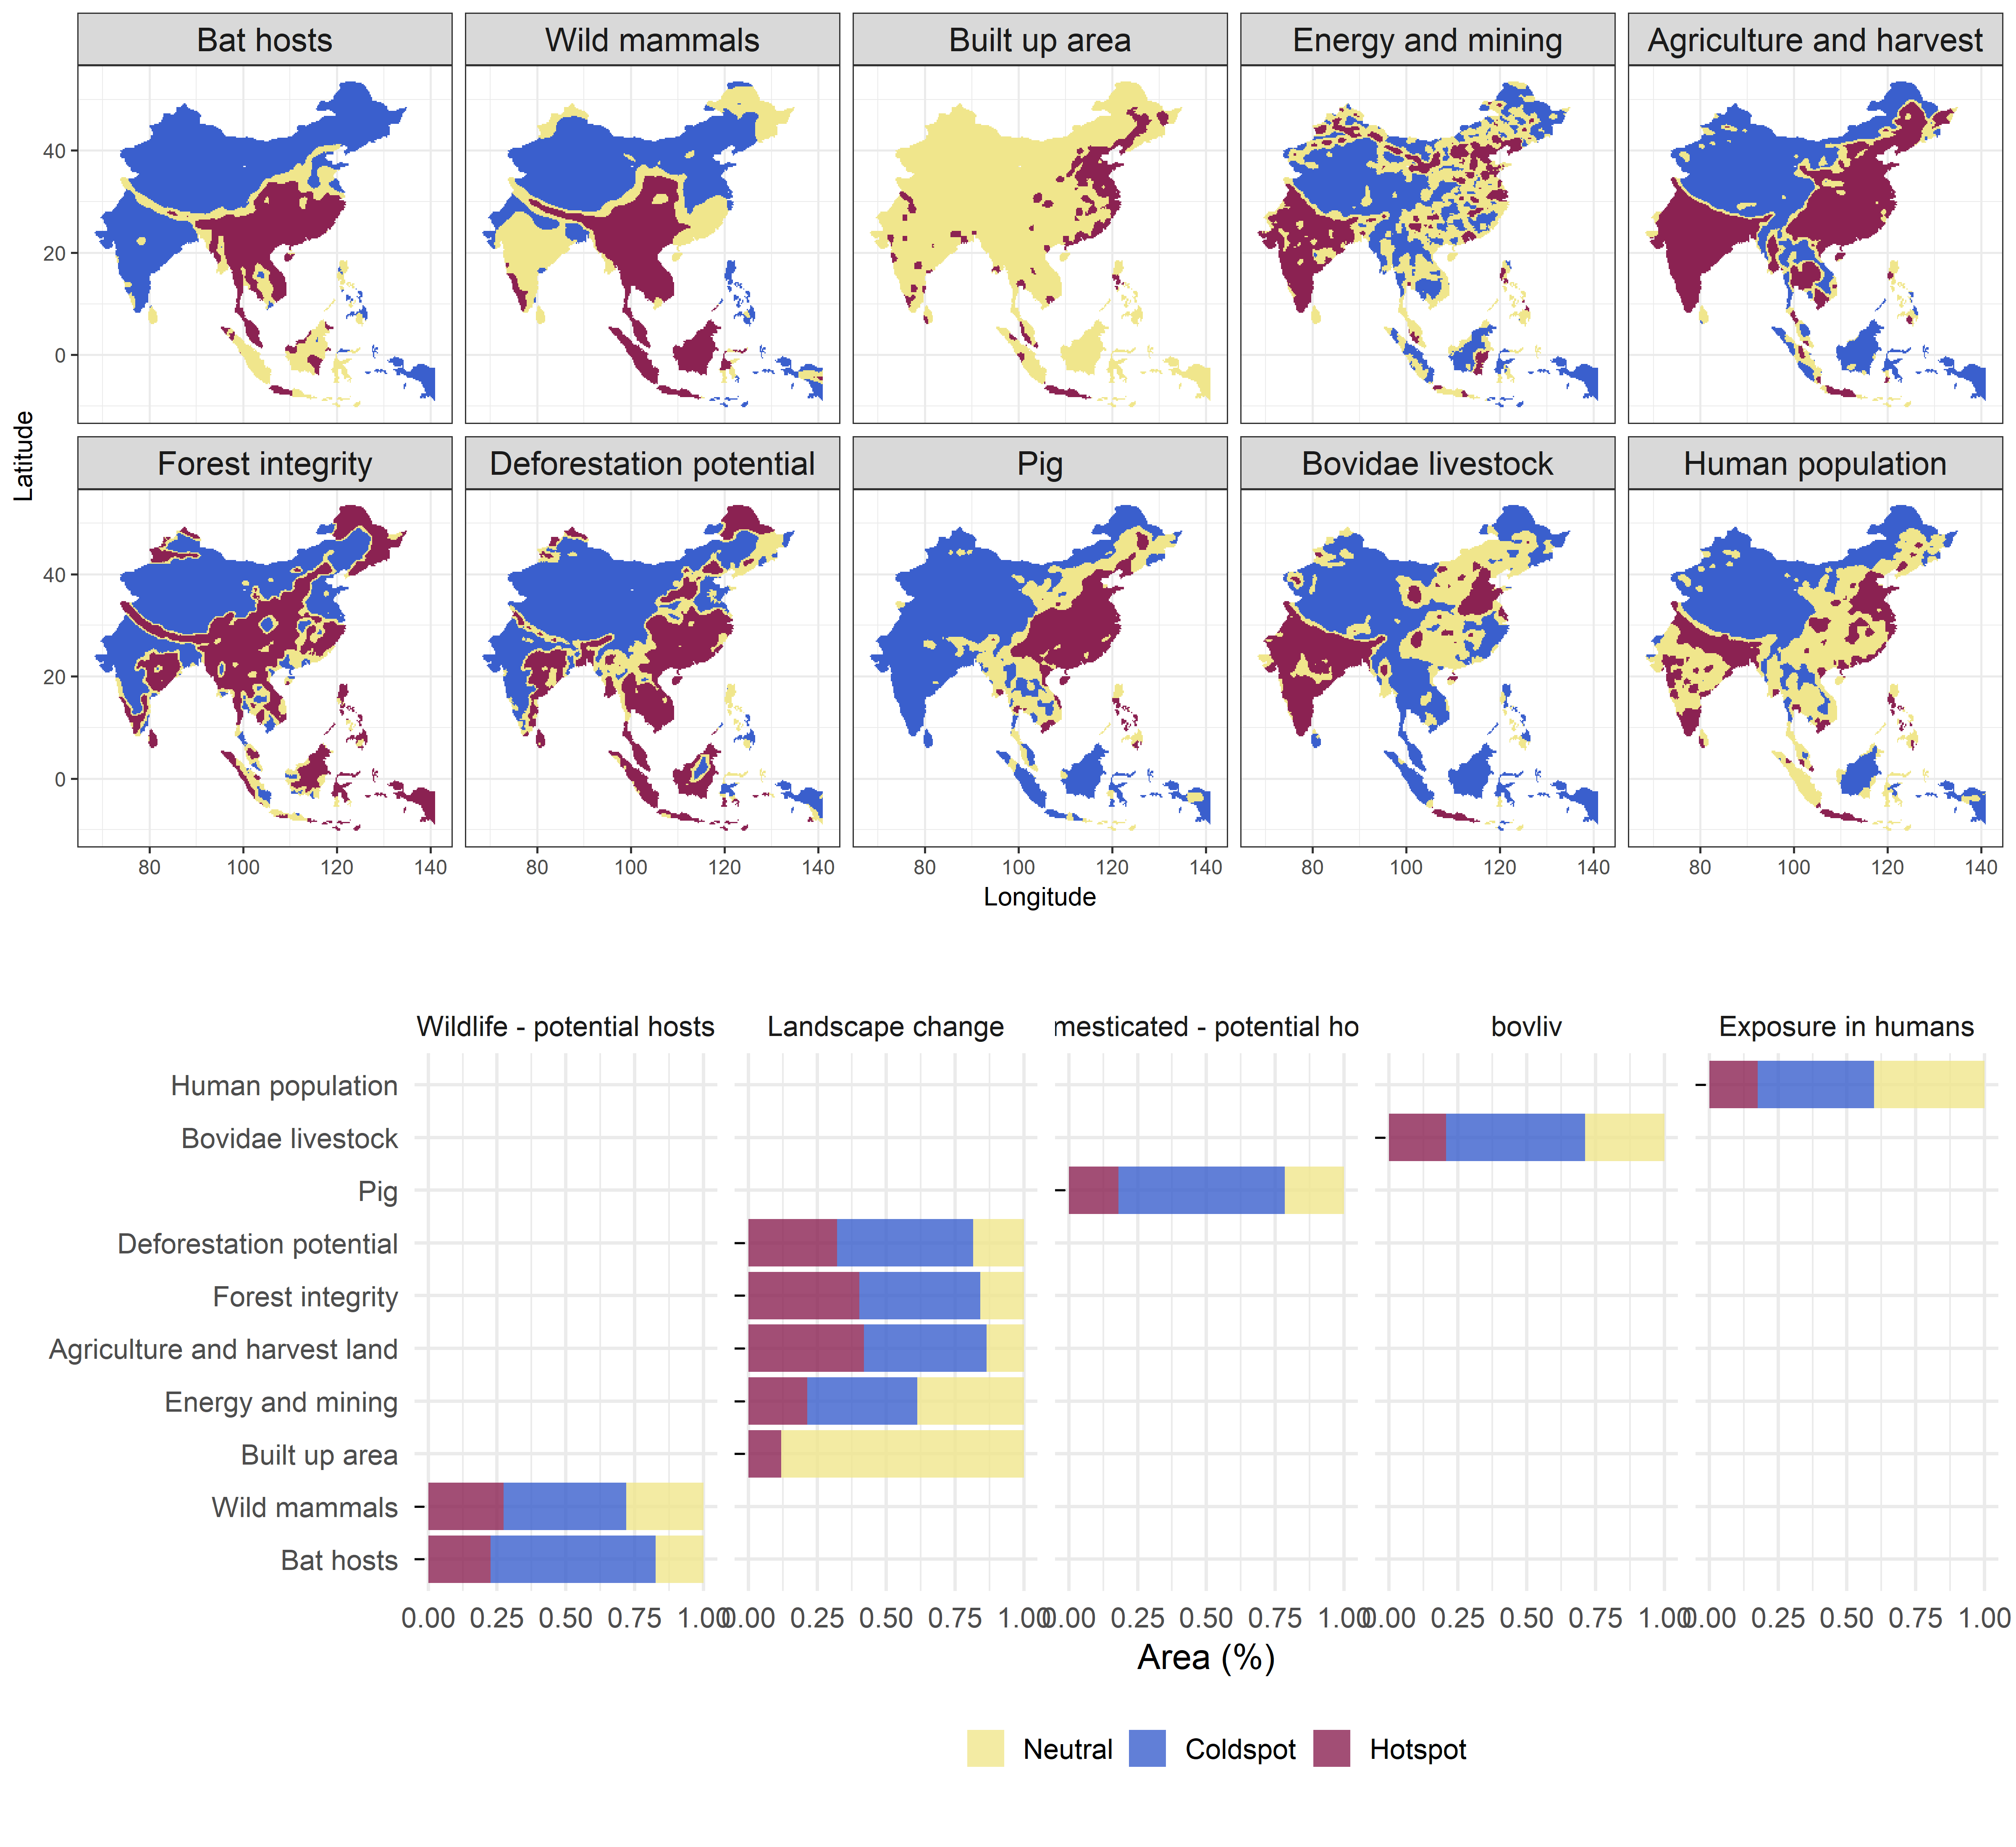


Changes on what is the mammal layer:
Previously: all mammals (deleted)
Now: all mammals minus bat hosts (mmb)
Inclusion of all bovidae livestock (buffalo+sheep+goat+cattle) in comparison with cattle: present cattle OR bovidae livestock in the main text and the other in the supplements.

Slide 13
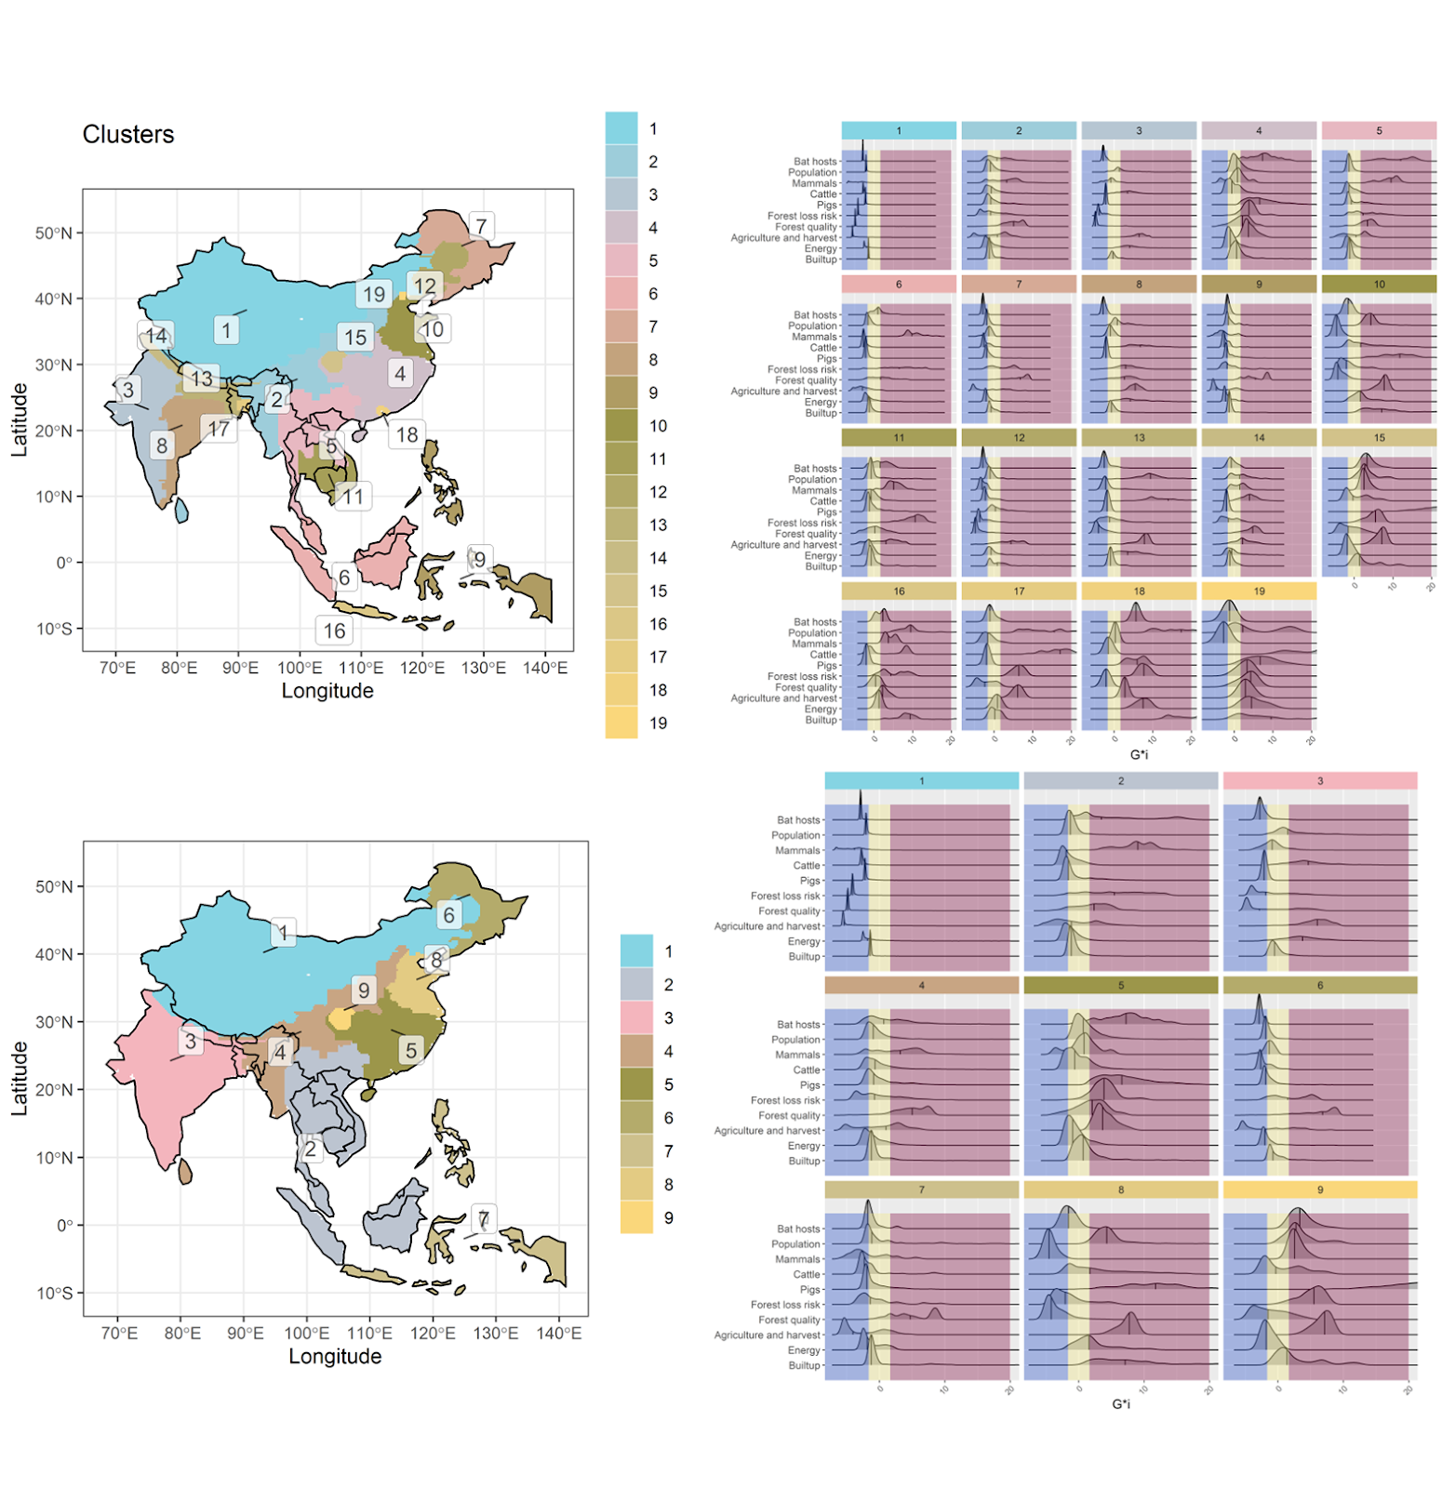
old

